Slide 1
Computer Graphics: Rendering
Autumn 2025
Lecture 1: Introduction and Course Organisation
Kartic Subr

Slide 2




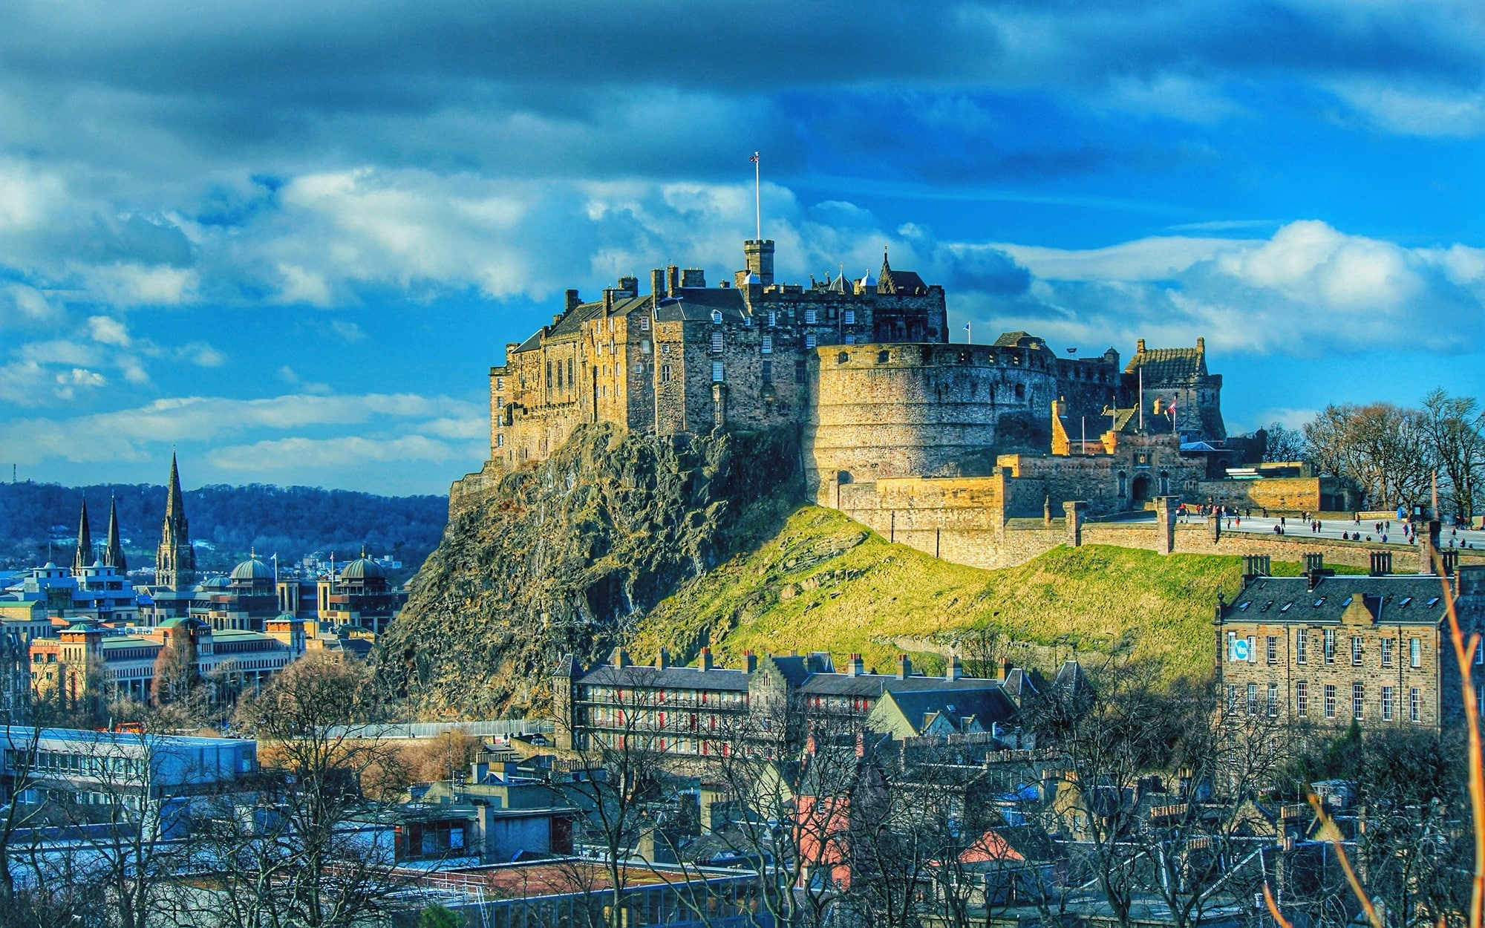




Me: A brief history

Slide 3


Video Games
(real-time)
Important Looking Pirates VFX
Special Effects
Assassin’s Creed Shadows 2025

Slide 4




Notes:
A common goal is to develop models and simulation mechanisms that mimic reality as closely as possible. But how is this ‘closely as possible’ defined?

Slide 5
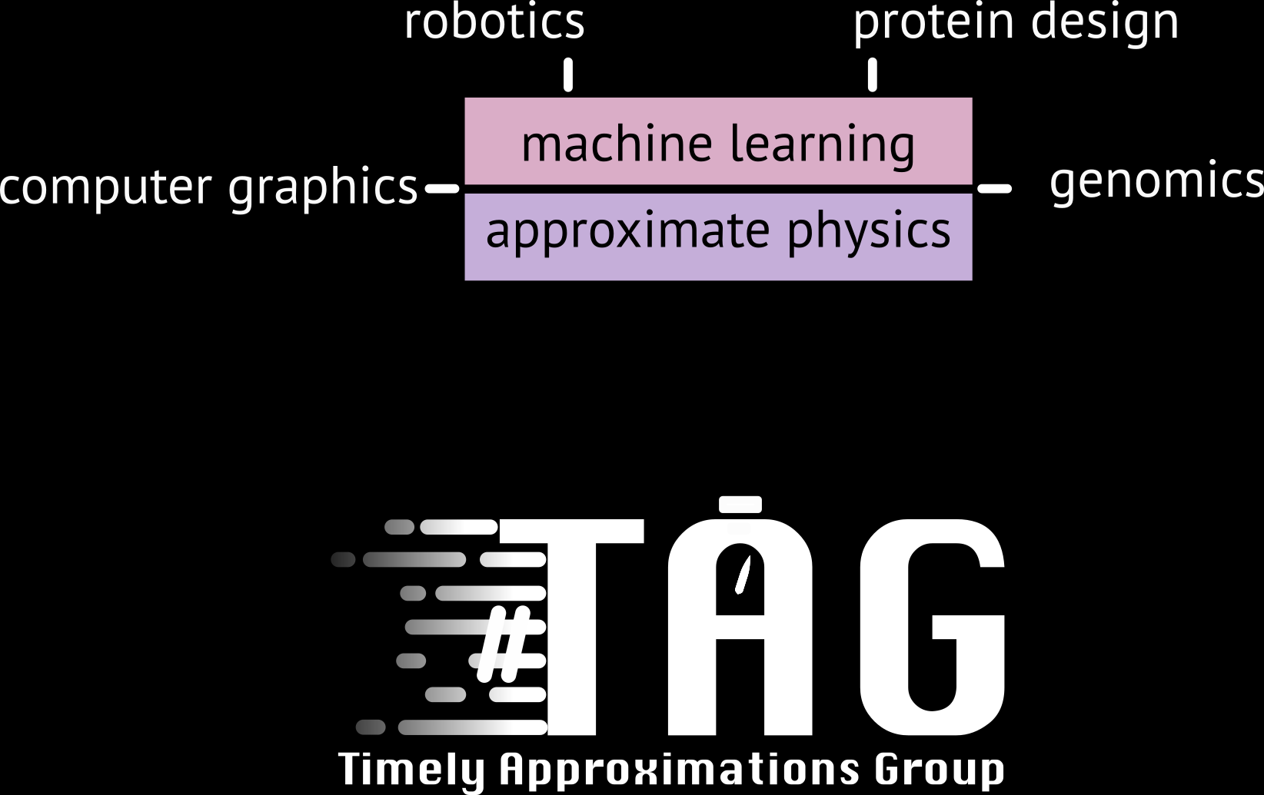


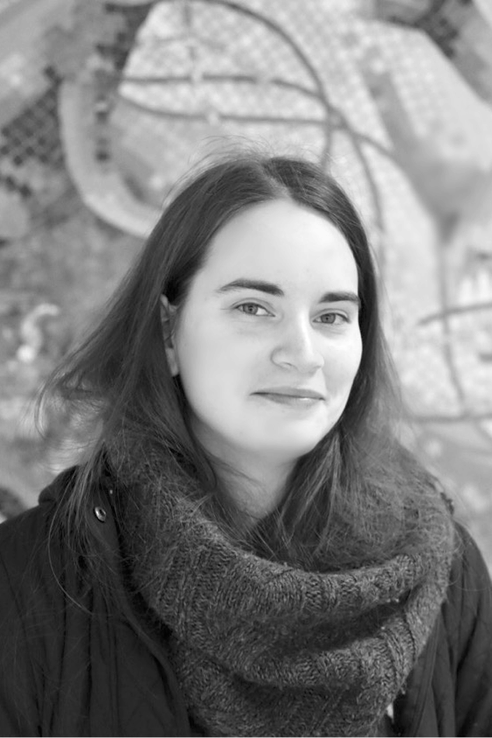


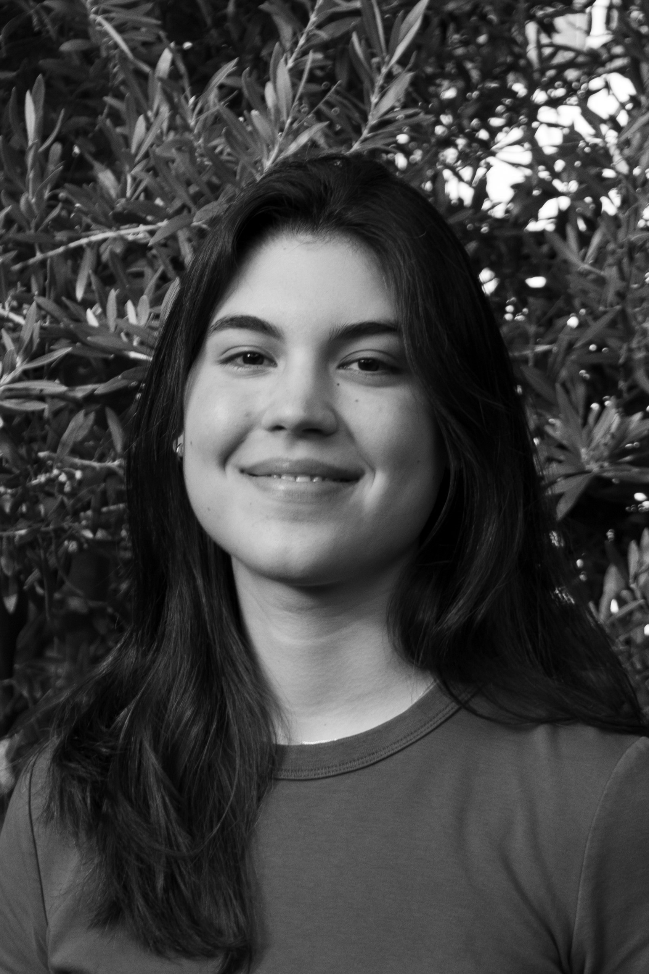


Slide 6
Sean Memery
(CGR 2023)
PhD student, NLP CDT
Tutor on this course
Constance Frachon
(CGR 2024)
PhD student, Robotics CDT

Slide 7
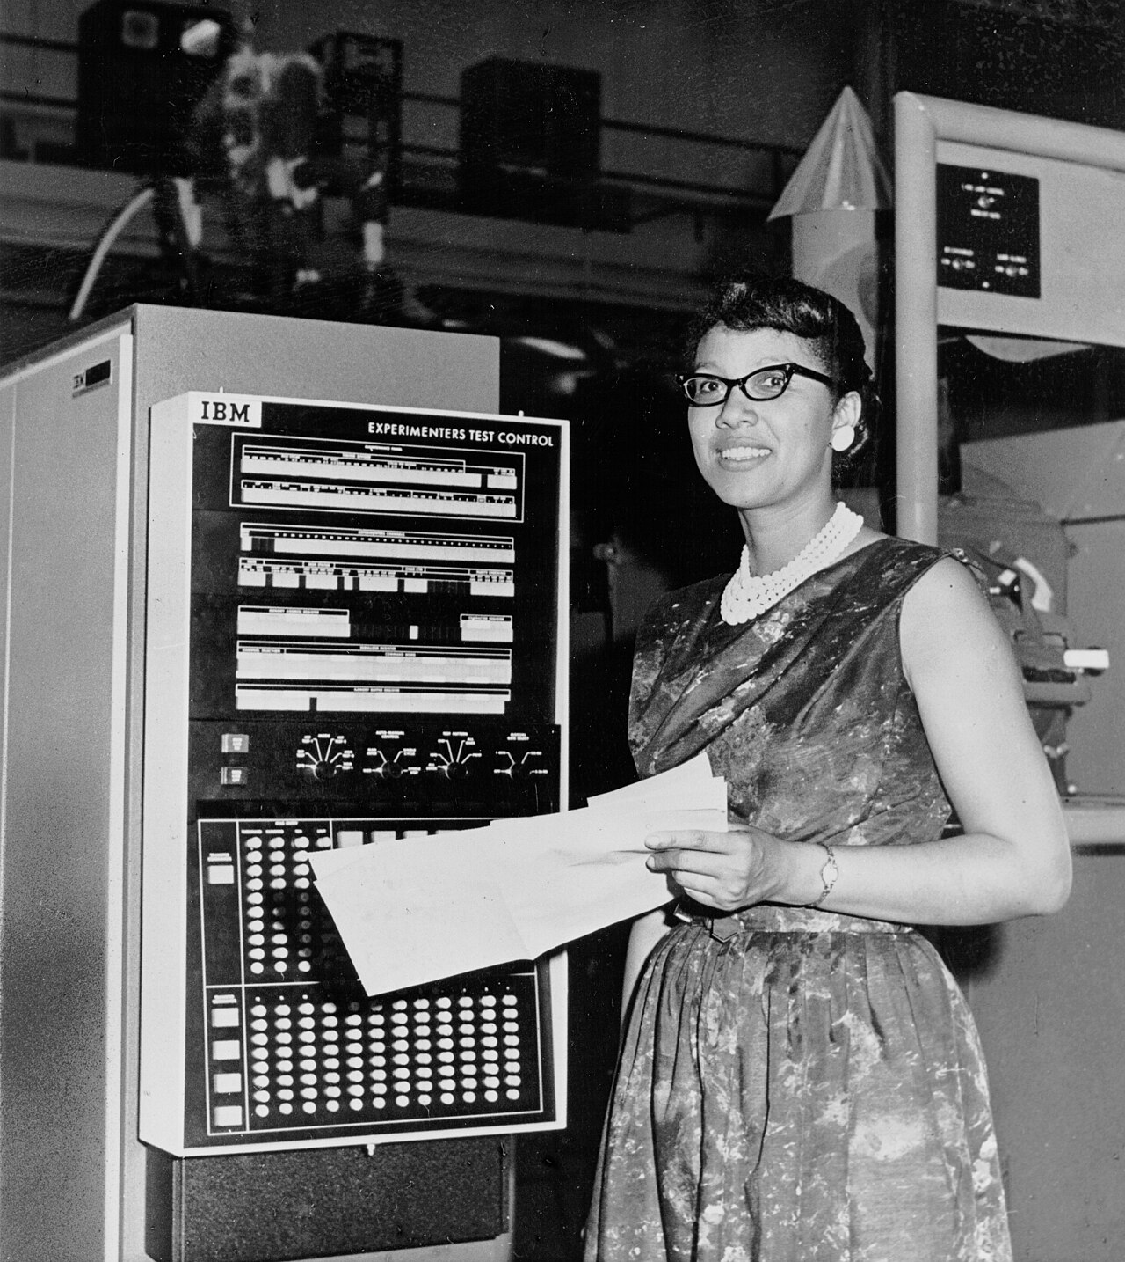

Slide 8

Notes:
A common goal is to develop models and simulation mechanisms that mimic reality as closely as possible. But how is this ‘closely as possible’ defined?

Slide 9
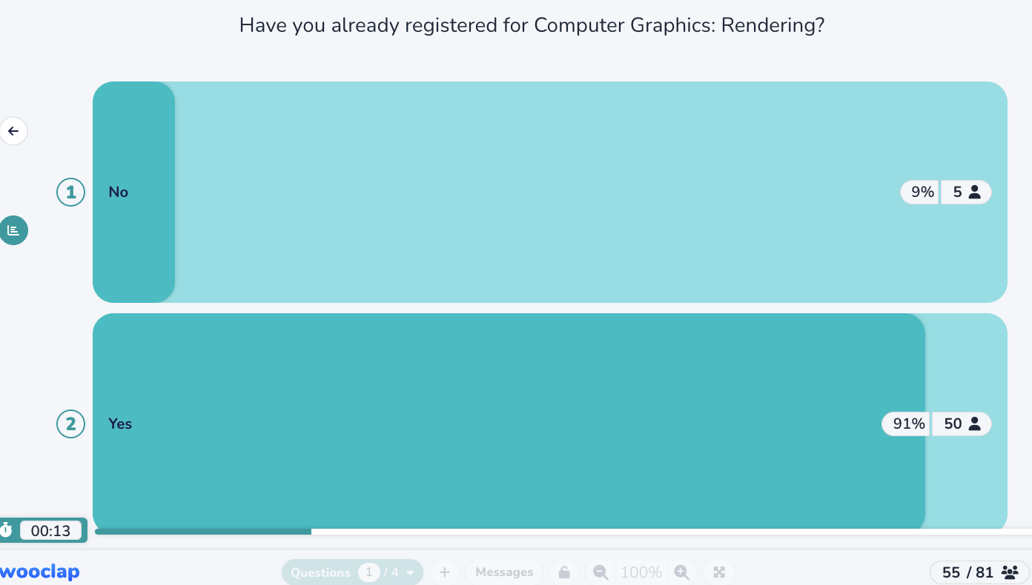

Slide 10
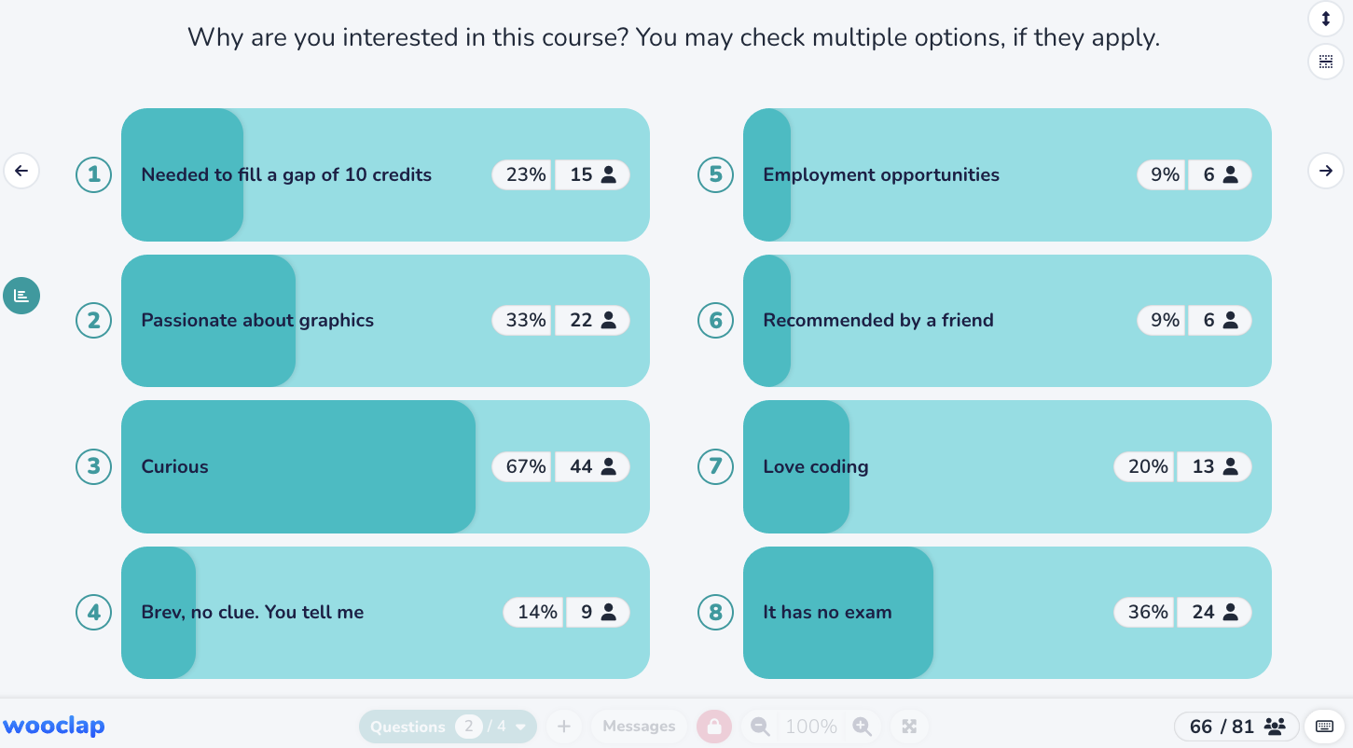

Slide 11
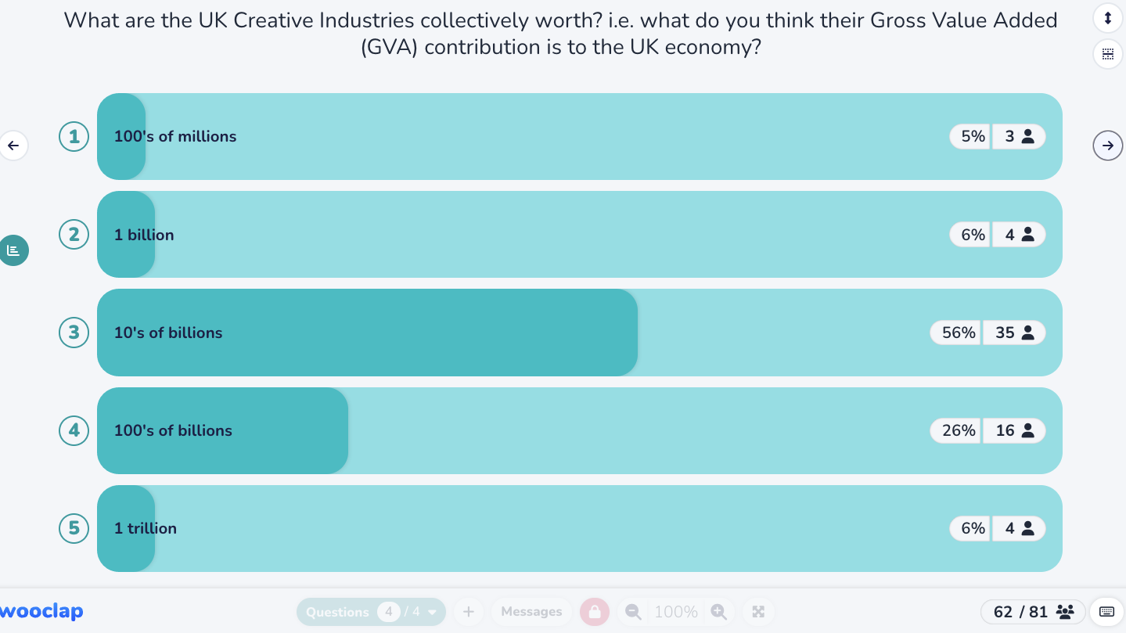

Slide 12
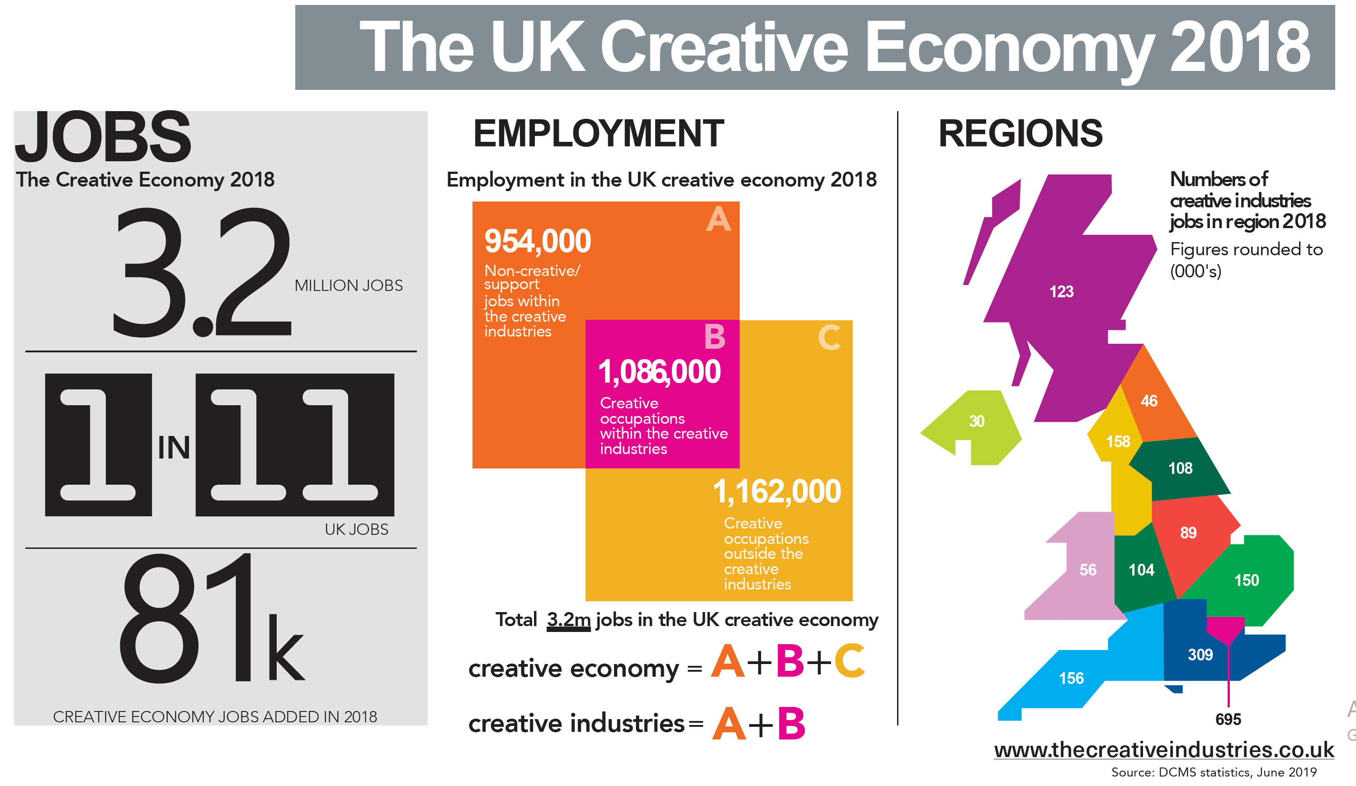
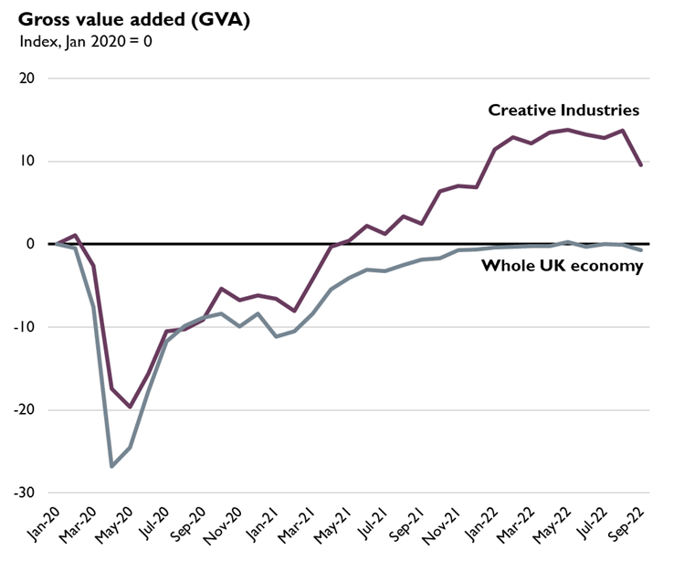
Creative Industries in the UK
https://lordslibrary.parliament.uk/arts-and-creative-industries-the-case-for-a-strategy/

Slide 13
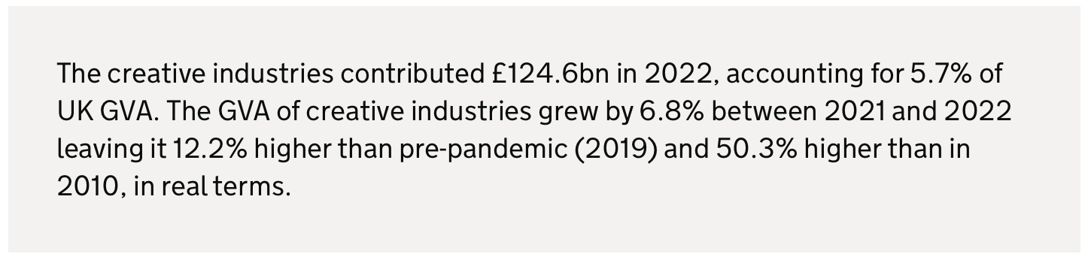
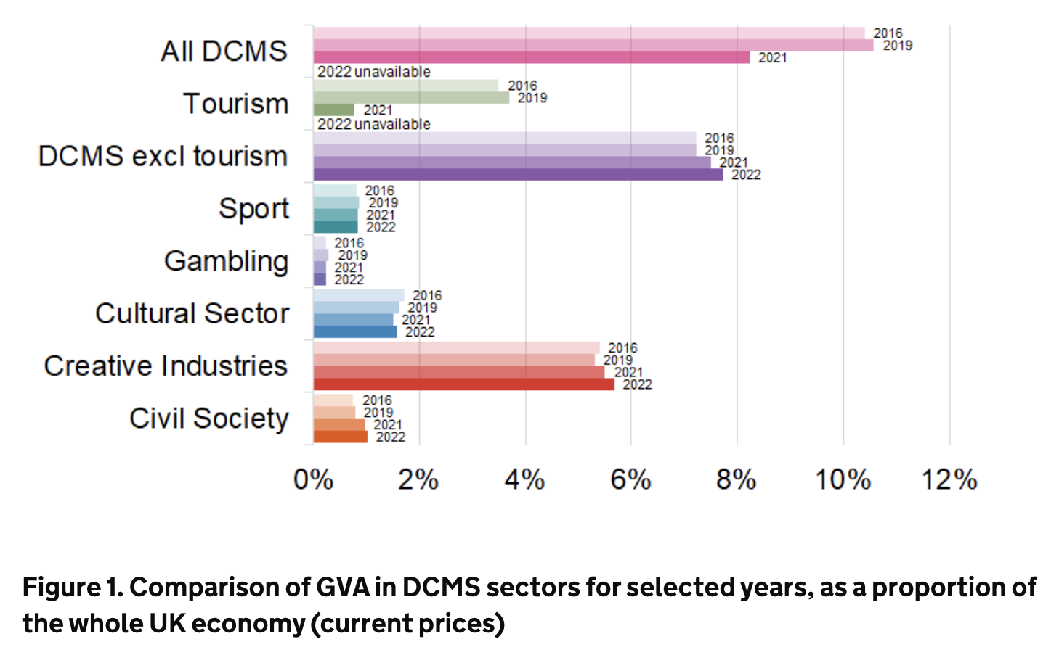
CGR is central to the creative industries
Source: DCMS report 2024

Slide 14
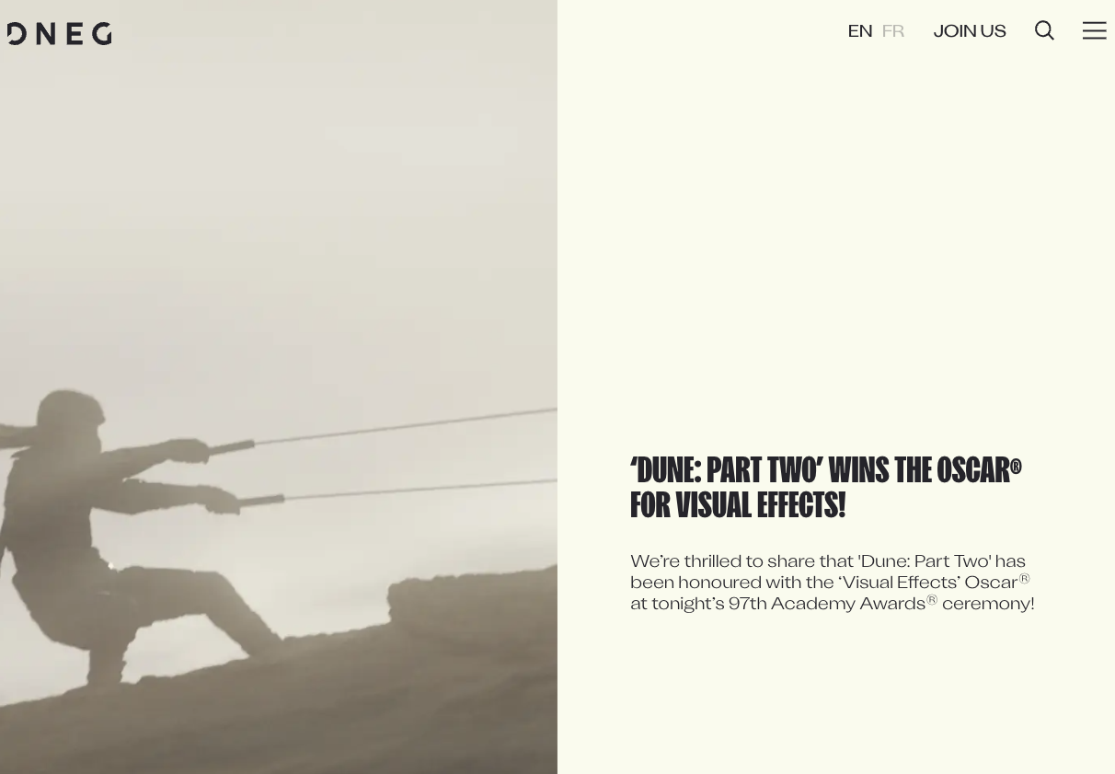

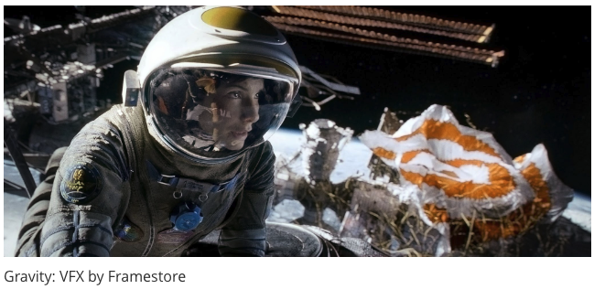
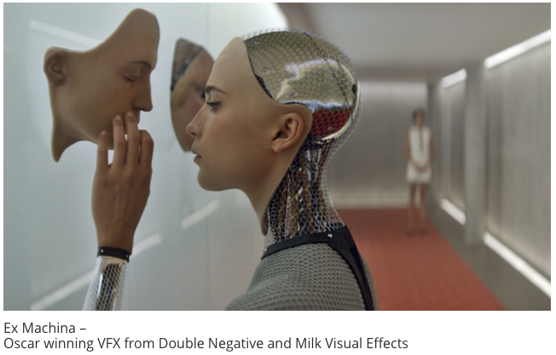
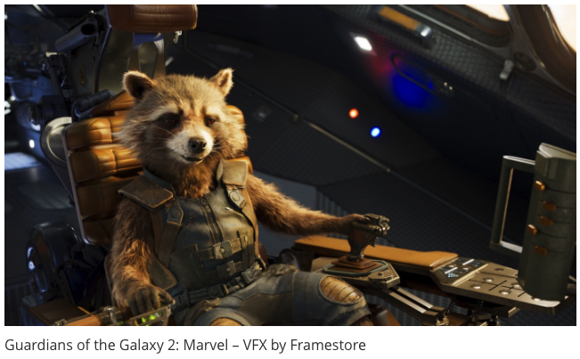

It’s all happening here in the UK!

Slide 15
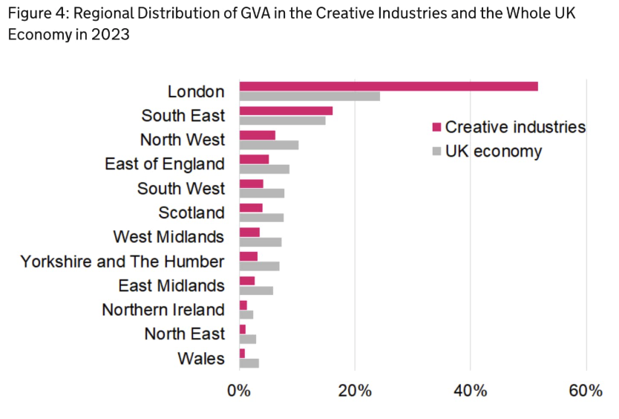
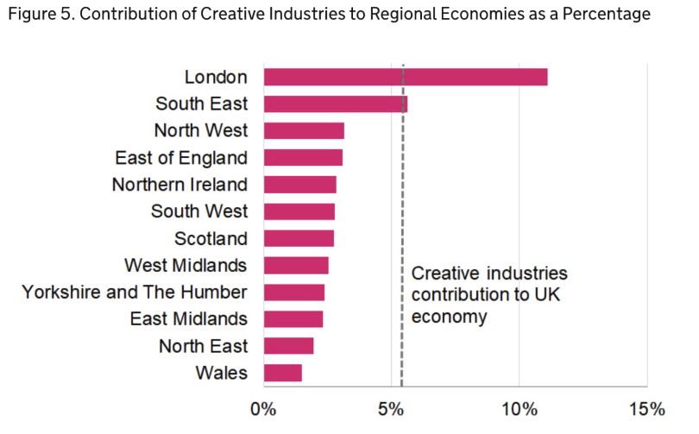
Room for improvement in Scotland …
https://www.thecreativeindustries.co.uk/facts-figures/data-highlights-potential-for-growth-in-regional-economic-contribution-from-creative-industries

Slide 16
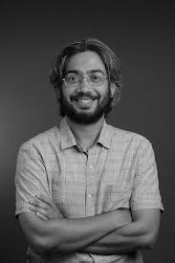
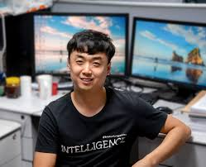
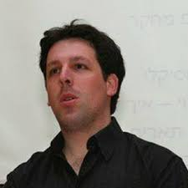
Edinburgh Graphics Lab
More news coming soon…

Slide 17

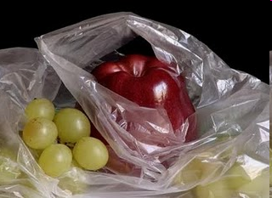

Simulating photorealistic pictures?
photograph
manually painted
computer generated
Colourbox.com
Pedro Campos

Slide 18
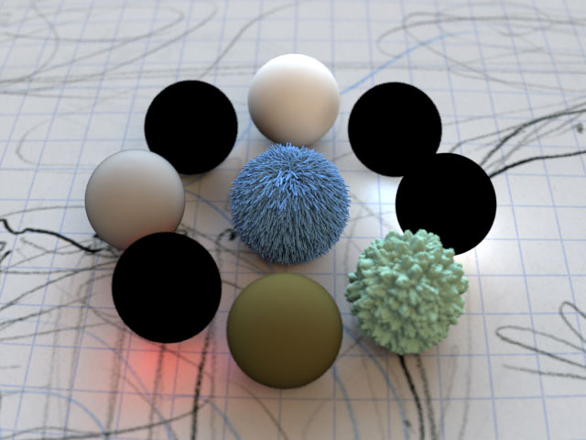
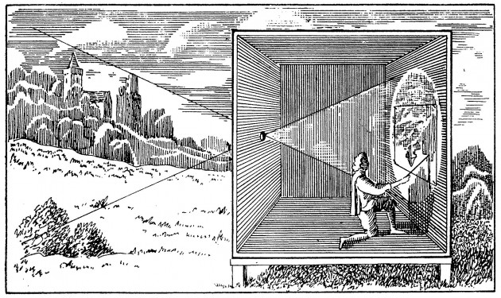
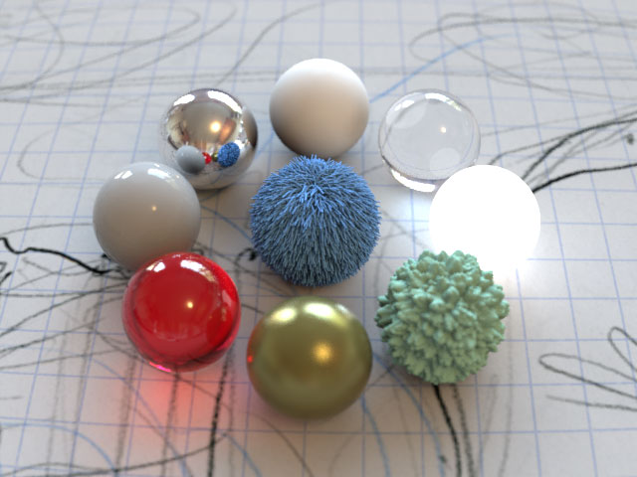
Physically based simulation, at its core!
Projective geometry
Energy
(light transport)

Slide 19
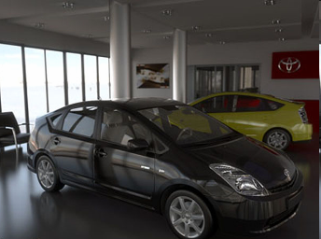
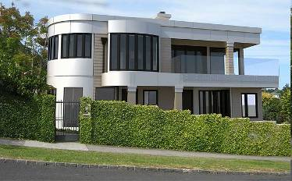
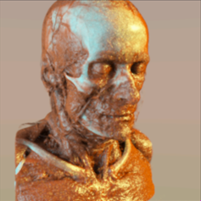
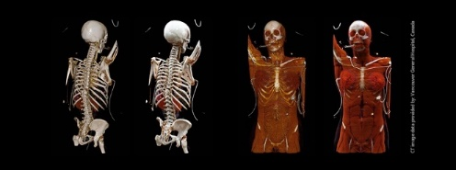
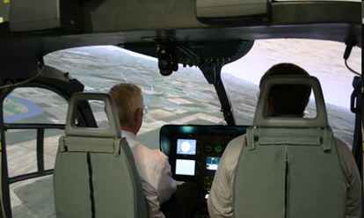

Advertising
Engineering
Medicine
Defense
Entertainment

Slide 20
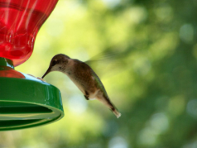


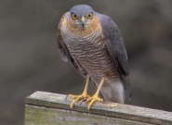

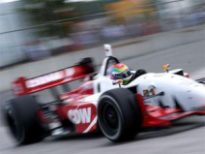


Simulate the physics of light
lenses
defocus
exposure time
light, media
materials

Slide 21
Assessment
coursework only (no exam)
1 coursework assignment worth 80%
4 Labs each worth 5% totalling 20%
class split into 5 groups for labs
This course recommends the use of coding assistants: GPT, co-pilot, Edinburgh University’s ELM (click here)

Slide 22
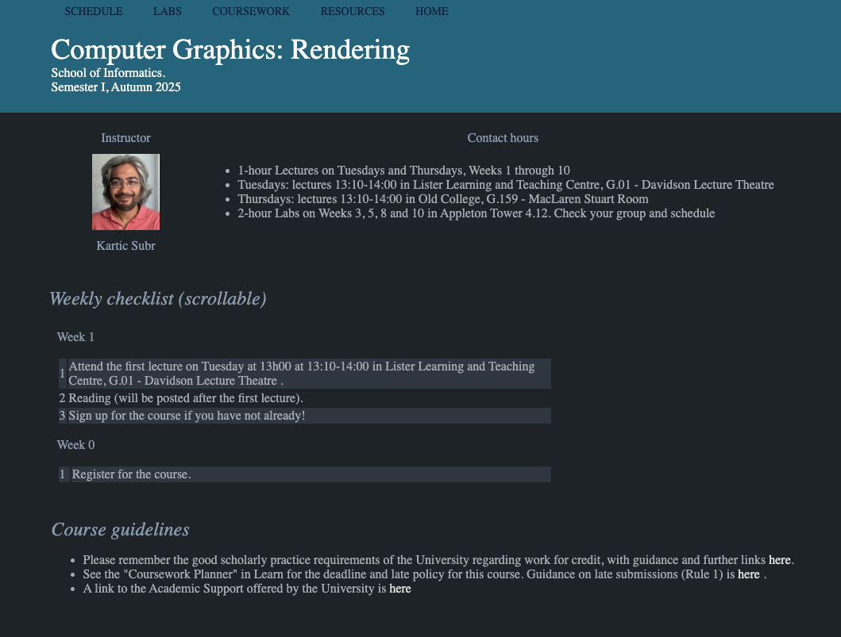
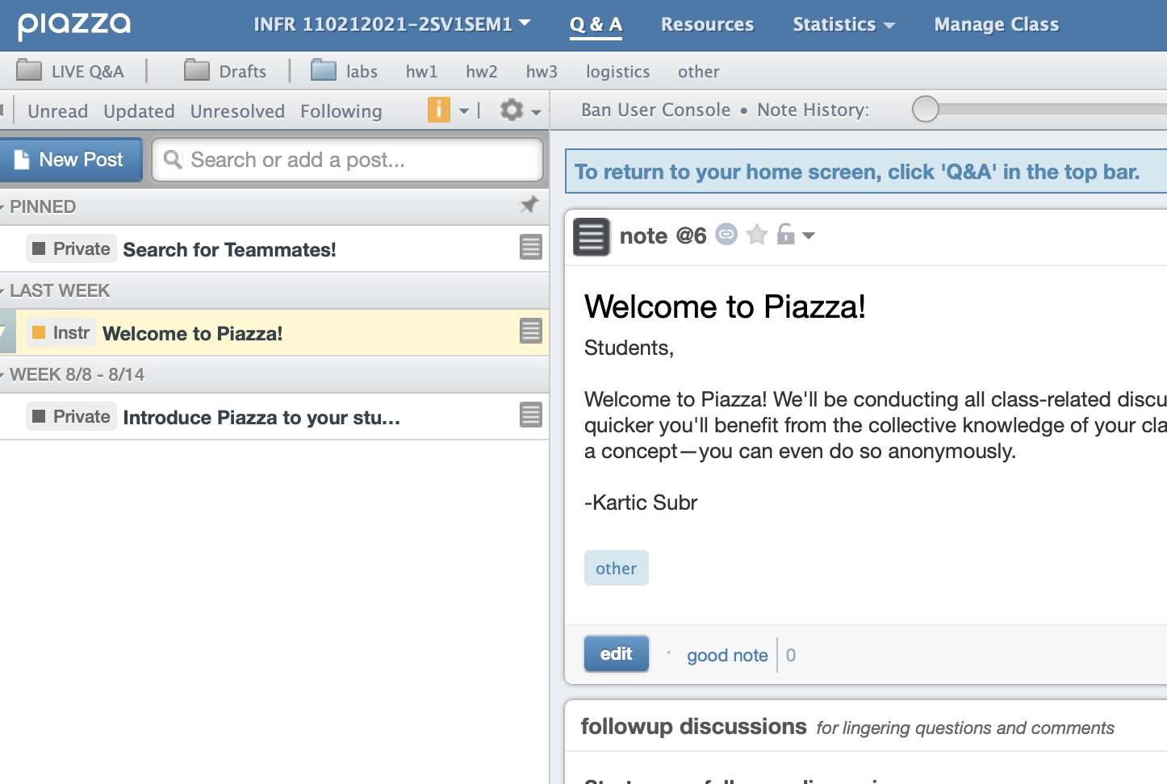

Logistics
Course website
https://ksubr.github.io/CGR2025/
Ask me!
piazza

Slide 23

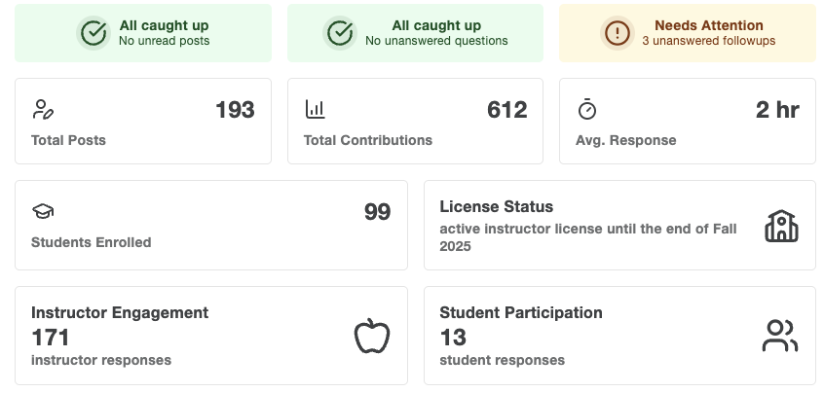
Logistics
Course website
https://ksubr.github.io/CGR2025/
Ask me!
piazza

Slide 24
CGR 2024 (Last Year)
Contact hours (19h)
16h lectures
3h tutorials
Self-directed (80h)
6h creative thinking
37h CW1 (for 80%)
37h CW2 (for 70%)

Slide 25
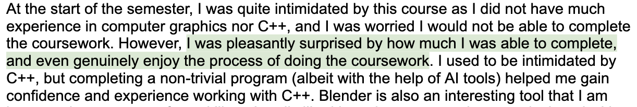
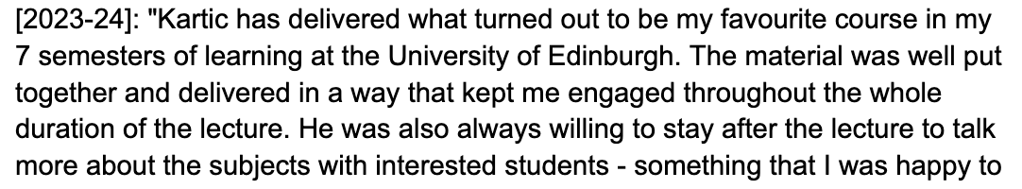
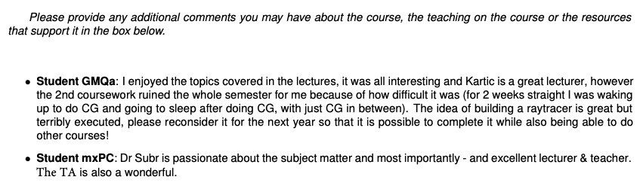
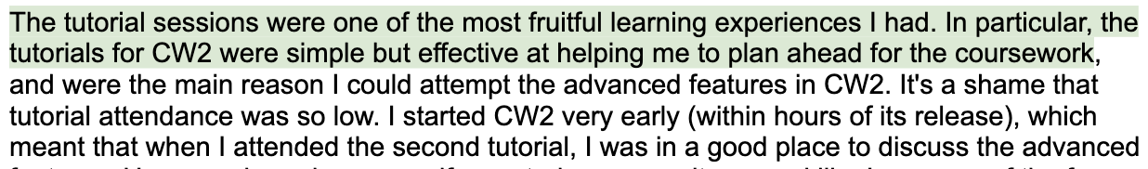
Feedback (2023) …

Slide 26
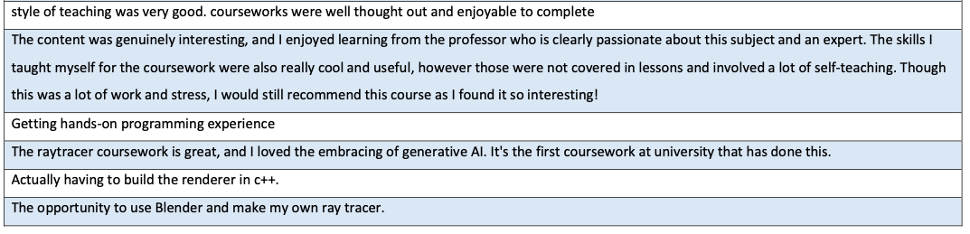
Feedback (2024)
19 students/107!

Slide 27
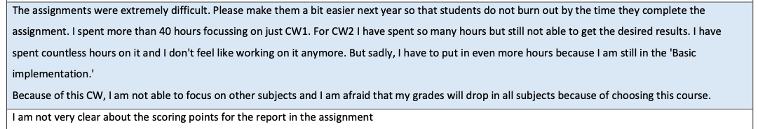
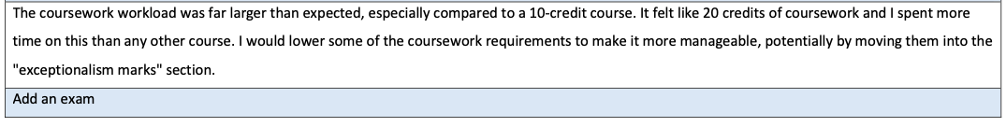
Criticism/suggestions (2024)

Slide 28
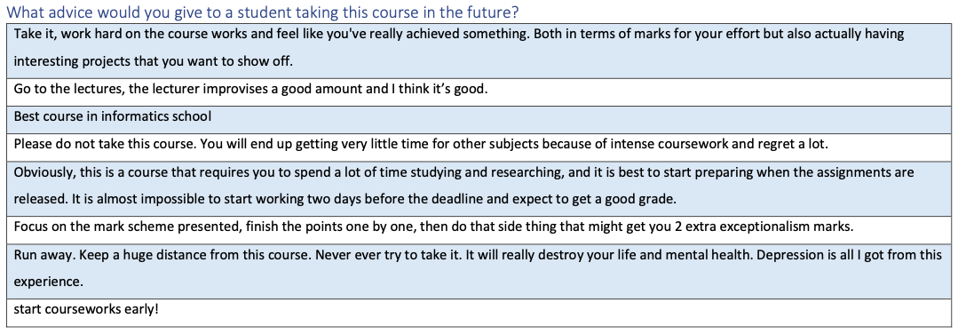

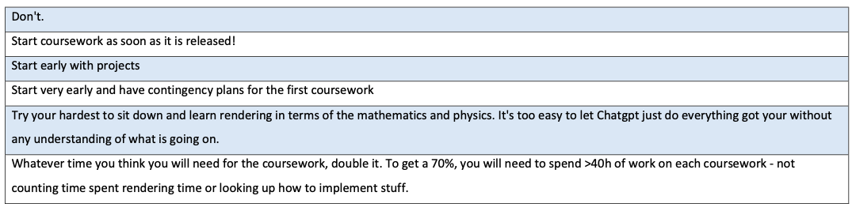

Slide 29
CGR 2024 (Last Year)
Contact hours (19h)
16h lectures
3h tutorials
Self-directed (80h)
6h reading/creative thinking
37h CW1 (for 80%)
37h CW2 (for 70%)

Slide 30
CGR 2025 (This Year)
More contact hours (27h)
19h lectures
8h labs (for 20 marks)
Single CW (36h)
36h CW1 (for 80 marks)
Incentive to submit intermediate checkpoints
- Independent Reading (12h)

Slide 31
CW Assessment: New this year!
Module 1
Module 2
Module 3
Final
6 Oct
21st Nov
17th Oct
5th Dec
31st Oct
optional
optional
optional
Main submission
Marked out of 60
Max timeliness bonus 20
+
Max total 80 marks

Slide 32
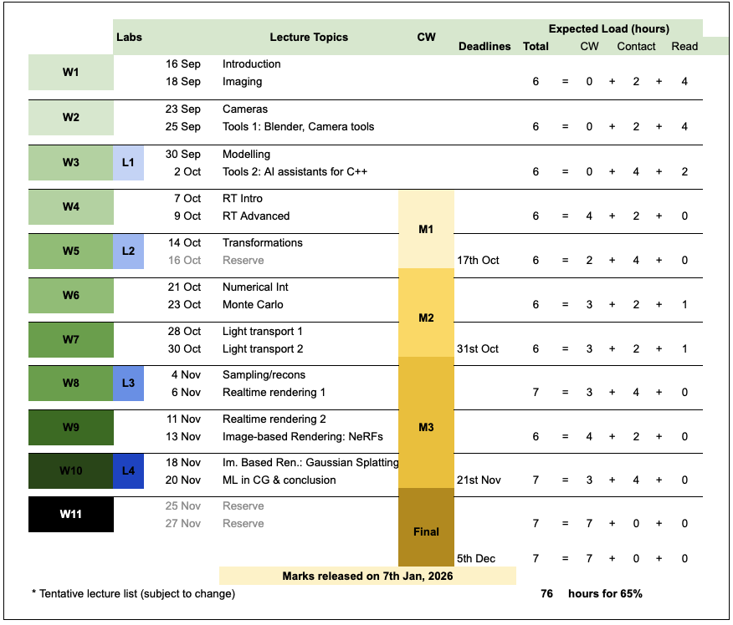
CGR 2025 (This Year)

Slide 33
Top tips
Try to attend as many lectures as possible
Work regularly – not just before deadlines
Use your opportunity to interact with me!

